Slide 1






DEPARTMENT OF MECHANICAL ENGINEERING 18MEP201L- MINOR PROJECT II FIRST REVIEW TITLE OF THE PROJECT: WHEELS OPERATED PESTICIDE SPRAYER DATE: 16/05/2024.
UNDER THE GUIDANCE OF
Dr. M MOHANPRASAD M.E ,MBA, Ph.D.
Associate Professor
DEPT . OF Mechanical Engineering
TEAM MEMBERS
KARAN S(927622BME034)
KARUNAKARAN S(927622BME035)
LIVINKUMAR M(927622BME307)

Slide 2
OVERVIEW OF THE PRESENTATION
ABSTRACT
INTRODUCTION
COMPONENTS
WORKING PRINCIPLE
PICTURE OF COMPONENTS
TABLE OF CONTENTS
2D DIAGRAM
WORKING MODEL
APPLICATION
ADVANTAGES
DISADVANTAGES

Slide 3
ABSTRACT
The project is intended to help the farmers as India being an Agriculture based country.
It is a water Sprayer mounted on a movable frame which is operated mechanically without any external source of energy.
The aim of developing such a concept is primarily because of preventing the three major drawbacks of the pump being used currently.
Firstly, the farmer has to carry the entire weight of the spraying pump on his shoulder.
Secondly, he has to continuously use his one hand to pump using the handle.
Thirdly, the farmers don’t take enough precaution while handling chemicals which results in fatal diseases because of its direct contact.

Slide 4
INTRODUCTION
Small scale farmers are very interested in manually level operated knapsack sprayer because of its versatility, cost and design.
Spraying is an important operation to be performed by the farmers to protect the cultivated crops from insects, pests, funguses and diseases in which various insecticides, pesticides, fungicides and nutrients are sprayed on crops.
So this gadgets which we called wheel operated fertilizer sprayer can be operated manually for spreading granular materials in farms especially for solid fertilizers like urea.

Slide 5
COMPONENTS
CHAIN DRIVE
WHEEL
DISC
NOZZLE
FRAME
BEARING
METAL STRIP
SHAFT
AGRICULTURAL SPRAYER

Slide 6
WORKING PRINCIPLE
Initially water or fertilizer which has to be sprayed is loaded inside the sprayer can and the setup is placed on the field where the spraying operation to be conducted.
A manual effort is applied on the chassis which allows the wheel mounted with it to rotate about its axis, this rotation allows the crank wheel attached with it to rotate.
This rotation tends to rotate sprocket gear and this makes hand lever of pump to activate linearly.
This activation pressurizes the fluid stored inside tank and makes it to exhaust through outlet.
This pressurized fluid from outlet is transferred to the nozzles from there the fluid is sprayed on the field.

Slide 7
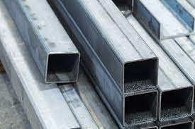
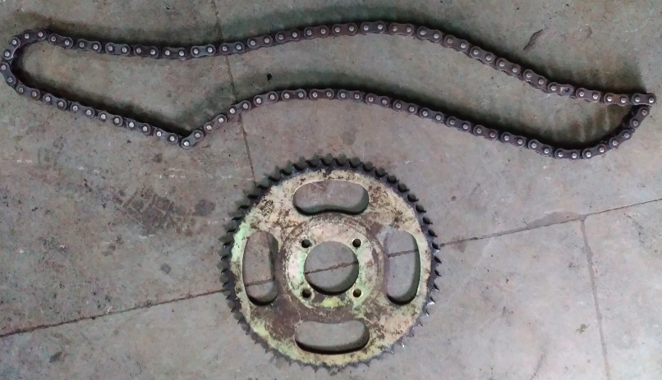
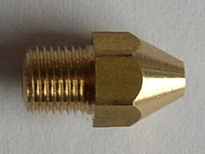
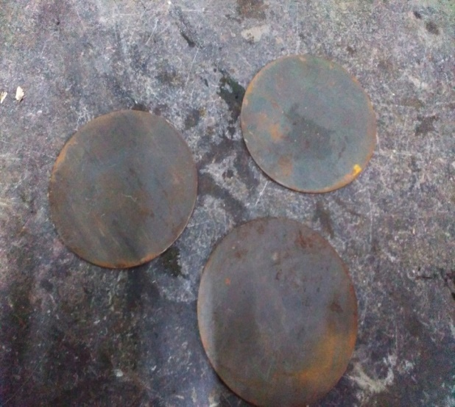
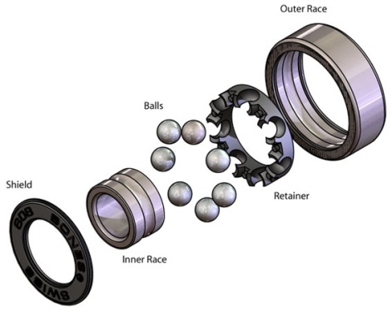
PICTURE OF COMPONENTS

Slide 8
TABLE OF CONTENTS
S.NO | DESCRIPTION | QTY | MATERIAL | COST
1 | CHAIN DRIVE | 1 | STAINLESS STEEL | 850
2 | NOZZLE | 1 | STAINLESS STEEL | 400
3 | BEARING | 4 | STAINLESS STEEL | 350
4 | FRAME | AS PER REQUIREMENT | MILD STEEL | 900
5 | SHAFT | AS PER REQUIREMENT | MILD STEEL | 350
6 | METAL STRIP | AS PER REQUIREMENT | MILD STEEL | 250

Slide 9
S.NO | DESCRIPTION | QTY | MATERIAL | COST
7 | AGRICULTURAL SPRAYER | 1 | PLASTIC | 650
8 | WHEEL | 1 | RUBBER | 550
9 | DISC | 1 | MILD STEEL | 650
10 | TOTAL | - | - | 5000

Slide 10
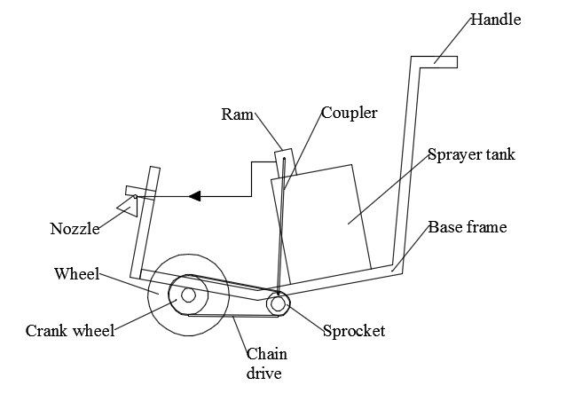
2D DIAGRAM

Slide 11
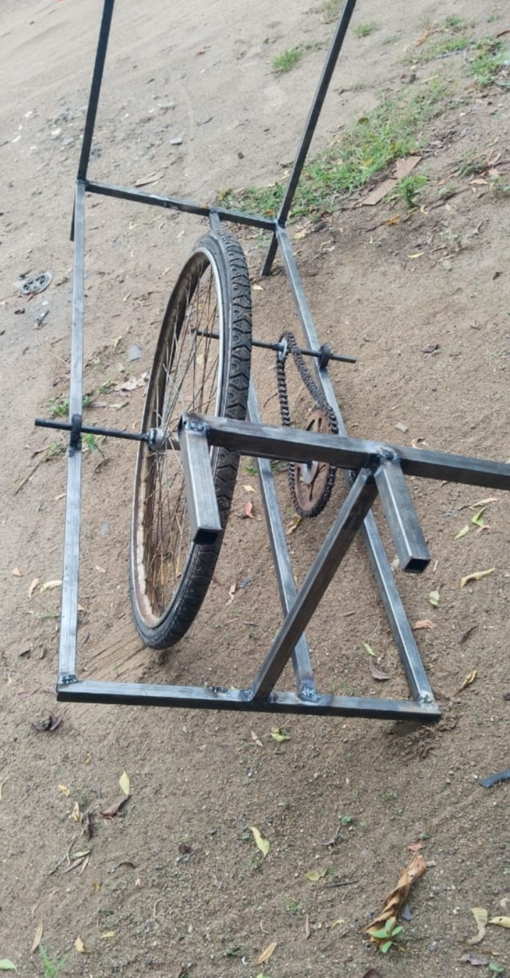
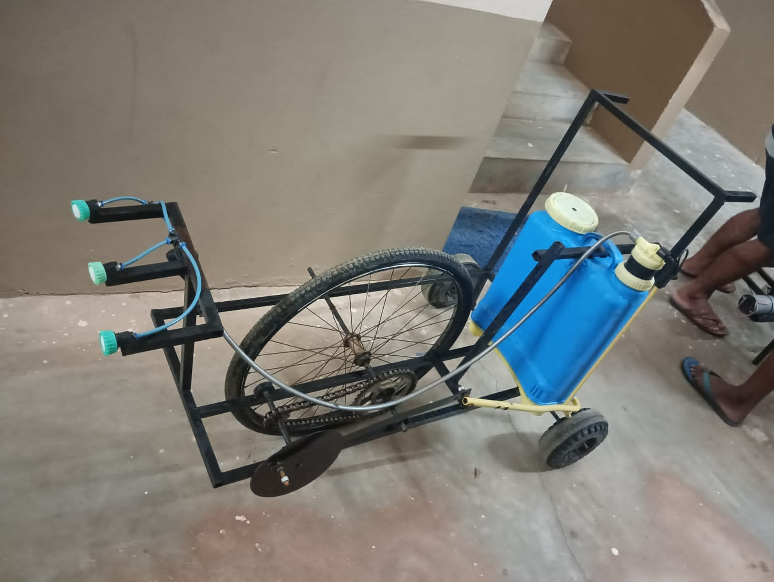
WORKING MODEL
BEFORE
AFTER

Slide 12
APPLICATION
This setup can be used for small and medium fields and by increasing the number of nozzles and specification of pump this setup can also be used for large fields also.

Slide 13
ADVANTAGES
Less Initial and Maintenance cost
Does not require any External Source of Energy
Safe for Operation
No Fatigue to Operator
Does not require to buy any Specially Designed Pump (conventional backpack pump can be directly used here)
Can work efficiently during all Seasons
Uniform Spraying
Portable & Economic
No Running cost

Slide 14
DISADVANTAGES
In irregular area of land, it can difficult to operate.
In rainy days in muddy environment it is difficult to operate.
For irregular crops this pump is difficult to work.
The flow is very less & Can't be used for high flow operation.

Slide 15


